Slide 1
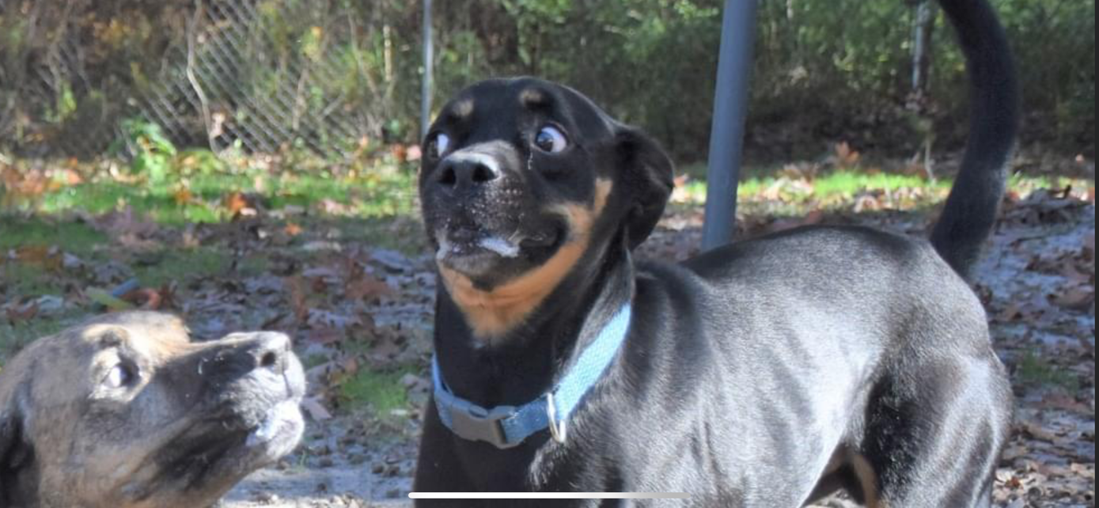
Dexxy
Dale Campbell
DSSA 5102

Slide 2
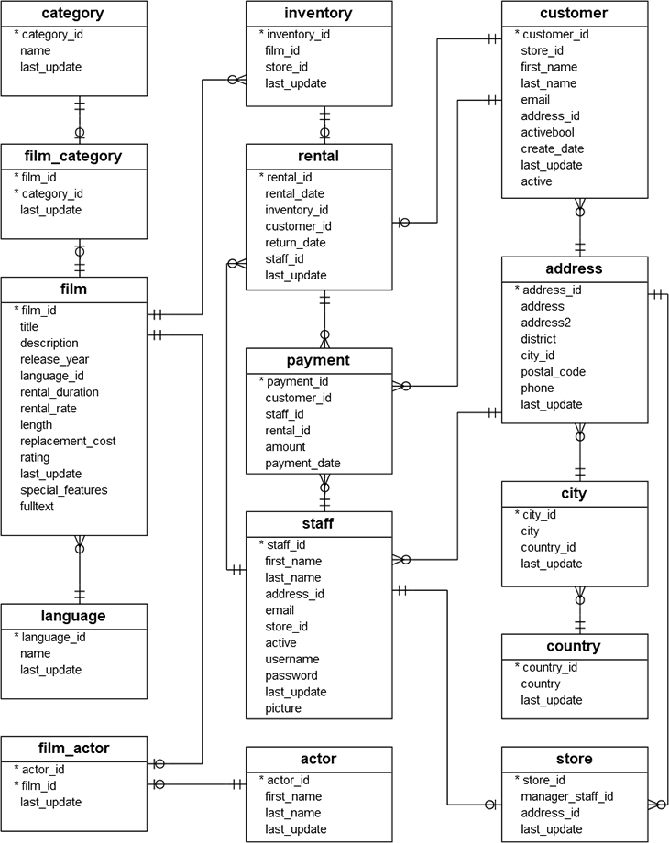
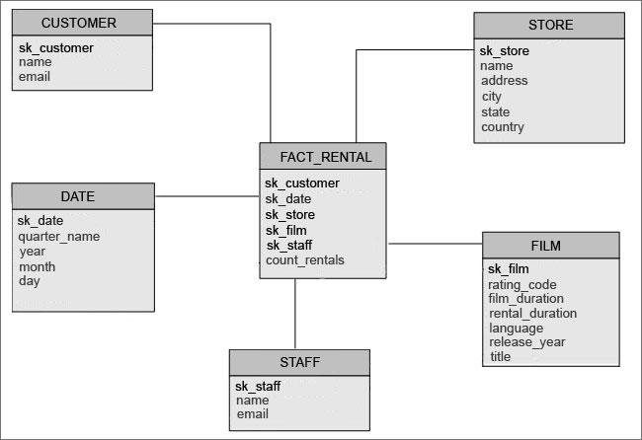
Project Objectives

Slide 3
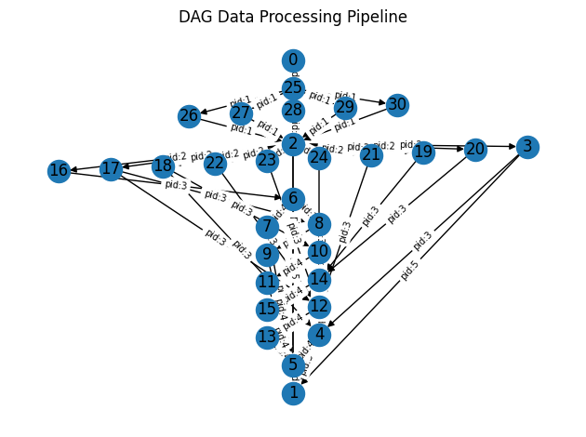
Process
Connect to dvdrental database
Extract Data
Transform Data
Load Data into data warehouse
Close connection

Slide 4
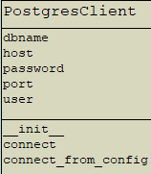
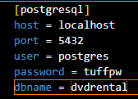
Setup
Class
Database.ini

Slide 5
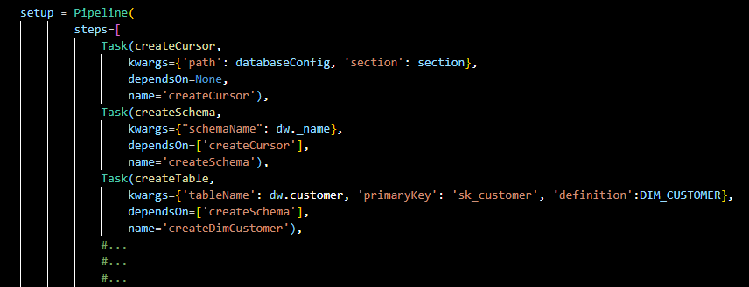
Setup Cont.
Create Schema
Create Dimension Tables
Customer
Store
Film
Staff
Dates
Create Fact Table
Rental

Slide 6
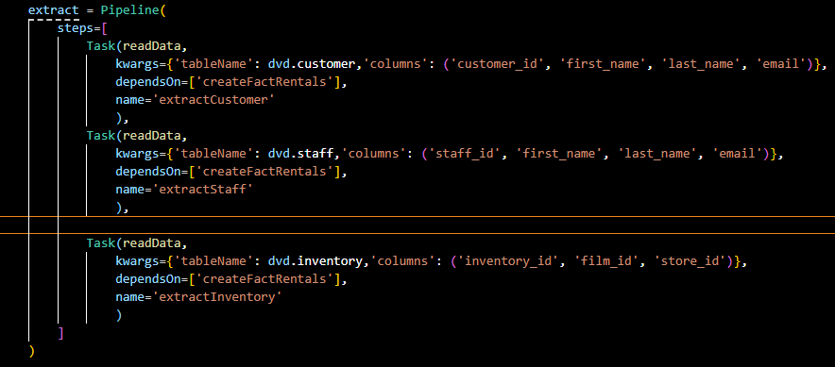
Extract
Read data from all available tables
Saves to df

Slide 7
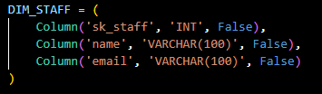
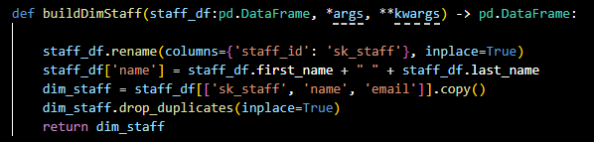
Transform
Formats dataframes to match table definitions

Slide 8
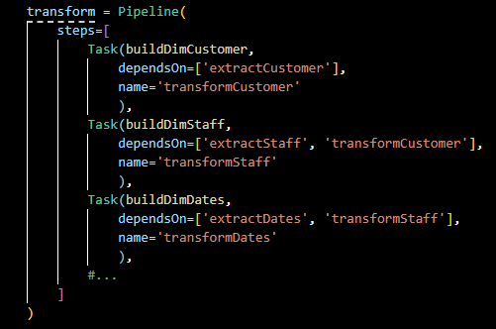
Transform Cont.
Repeats process for all tables

Slide 9
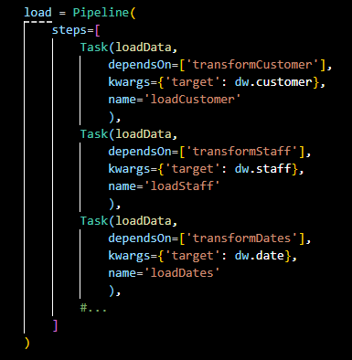
Load
Inserts the data to the data warehouse

Slide 10
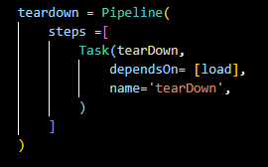
Teardown
Closes connection

Slide 11
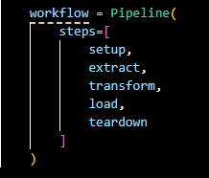
Workflow Combined

Slide 12
Limitations
Only allows for building ETL pipeline of dvdrental
Single threaded
No graphical user interface (GUI)

Slide 13
Questions?

